Slide 1


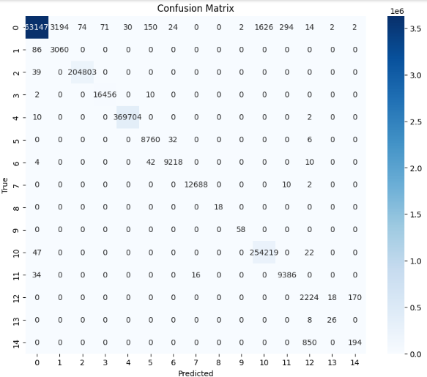
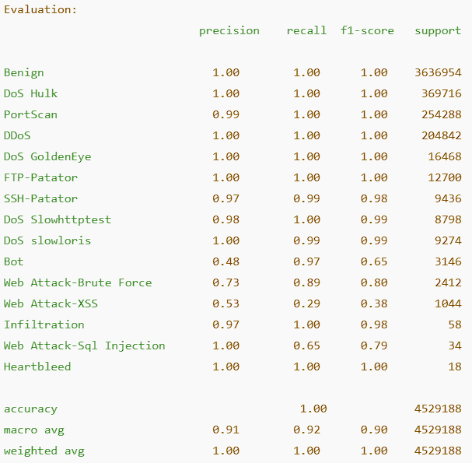
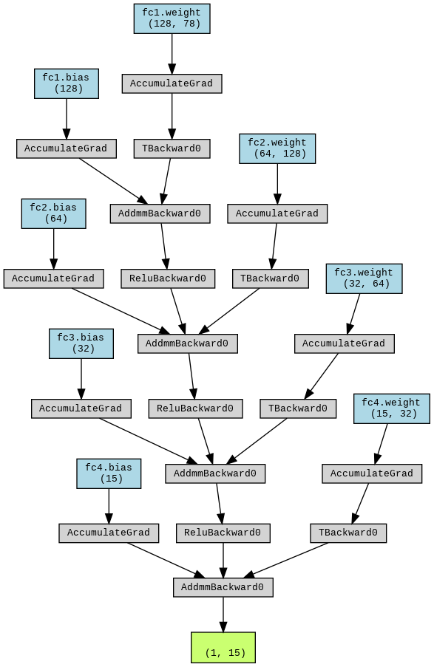
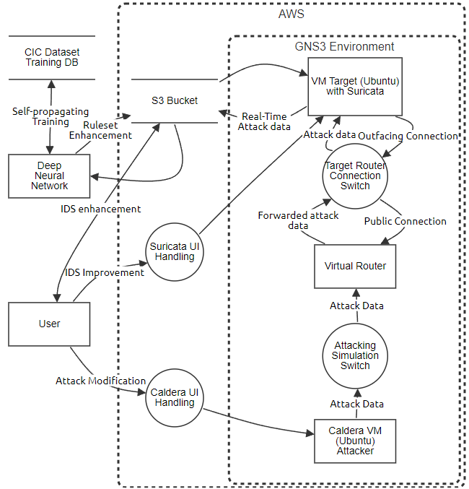
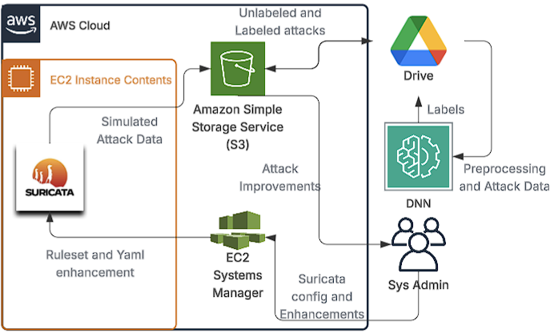
AI-Driven Threat Detection and Response System
Alex Lappin, Sumayah Alomari, Hussam Al Bakhat, Josh Puyat, Bibhu Paudyal, Mahi Khan
Background
AI Logic
Challenges and Discussion
Motivation: With rising cyber threats, real-time AI-driven detection is essential.
Problem: Traditional IDS tools struggle with false positives, noisy data, and evolving threats.
Preprocessing: Connects to cloud storage, cleans and merges CSVs, encodes labels, handles missing data, and splits datasets for training and testing.
Training the DNN: Normalizes data, uses weighted sampling for class imbalance, trains over multiple epochs, and saves the best-performing model.
Evaluation: Tests the model with classification metrics, predicts new data, decodes results, and outputs labeled CSVs.
Challenges:
Limited time/resources
Complex Suricata rule tuning
Lack of real-team labeled data
Discussion:
SHAP shows packet rate/size drive predictions
Top features: Fwd packets/s, Fwd packet length max
Minor classes underperform statistically
Objectives and Materials
Objective/Solution: We developed a DNN-based IDS on AWS, trained on labeled data for accurate, adaptive intrusion detection.
Materials:
Python libraries: PyTorch, PyTorch Lightning
Suricata IDS dataset (CSV-formatted)
Custom data preprocessing scripts
Confusion matrix for evaluation
Neural network flow diagrams
Results
Roadmap and Future Work
Our confusion matrix to visualize the performance of the DNN, comparing actual versus predicted labels
The best results of the DNN model after training for 125 epochs
Our neural network’s layer flow, highlighting data and gradient movement from input to output during training.
Future
- Integrate automated threat responses
- Test in real-time environments
- Try other AI models (e.g., RNNs)
- Optimize for edge deployment
References
Proof-of-concept Data Flow Diagram
H. H. Tran, et al, "Deep Inductive Transfer Learning Approach forNetwork Attacks Detection," ACOMPA, 2023.
Tabassi, E. (2023), Artificial Intelligence Risk Management Framework (AI RMF 1.0)
Mentor: adebarro@gmu.edu Sponsor: zwang52@gmu.edu
Implemented System Architecture

